Slide 1

CSE4037
REINFORCEMENT LEARNING
OPTIONS

Slide 2
Module No. 6
Hierarchical Reinforcement Learning
8 Hours
Hierarchical Reinforcement Learning
Types of Optimality
Semi MDP Model
Options
Learning with Options
Hierarchical Abstract Machines
A partially observable Markov decision process.

Slide 3
Options
An option is a generalization of the concept of action. It captures the idea that certain actions are composed of other sub-actions.
The option picking up an object, going to lunch, and traveling to a distant city is composed of other sub-actions (e.g. picking up an object), but is itself an action (or macro-action). A primitive action (e.g. joint torques) is itself an option.

Slide 4
Options
A set of options defined over an MDP constitutes a semi-Markov decision process (SMDP), which are MDPs where the time between actions is not constant but it is variable.
In other words, a semi-MDP (SMDP) is an extension of the concept of MDP that is used to deal with problems where there are actions of different levels of abstraction.
For example, consider a footballer that needs to take a freekick. The action "take a freekick" involves a sequence of other actions, like "run towards the ball", "look at the wall", etc. The action "take a freekick" takes a variable number of time steps (which depends on the other sub-actions).

Slide 5
Options
Semi-MDPs are thus used to deal with such problems that involve actions of different levels of abstraction. Hierarchical reinforcement learning (HRL) is a generalization (or extension) of reinforcement learning where the environment is modeled as a semi-MDP.
Semi-MDPs can be converted to MDPs.

Slide 6
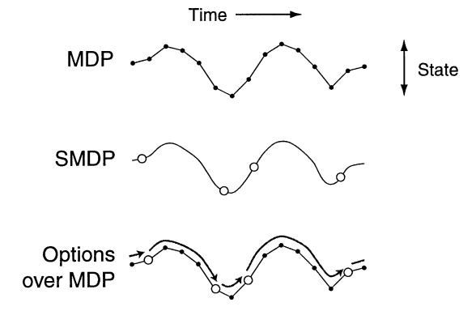
Options
The empty circles (in the middle) are options, while the black circles (at the top) are primitive actions (which are themselves options).

Slide 7
Options
Options represent closed-loop sub-behaviors, which are carried out for multiple timesteps until they trigger their termination condition.
Options are considered closed-loop systems because they adapt their behavior based on the current state. This is in contrast to open-loop systems, which do not adapt their behavior once initialized when confronted with a new state. It is often more realistic to model sub-behaviors as closed-loop systems than using open-loop sub-behaviors.
For example, while driving a car, if we would be committed to an open-loop option, we would not deviate if we encounter danger, a closed-loop option will alter its action based on the current state.

Slide 8
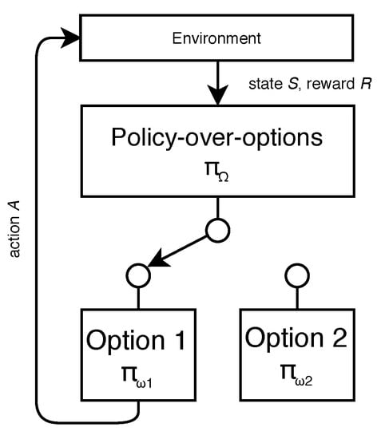
Options – Architecture

Slide 9
Options
The usage of options in a RL setting has been shown to speed up learning.
a way to summarize knowledge as an essential building block in a lifelong-learning setting.
the increased performance of using temporally extended actions using importance sampling.

Slide 10
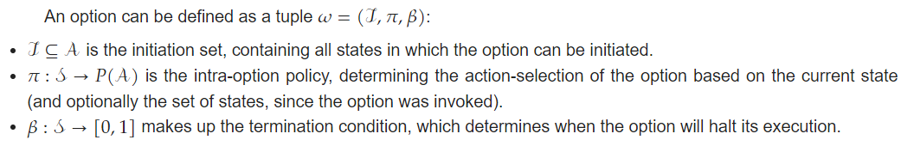
Options - Framework

Slide 11
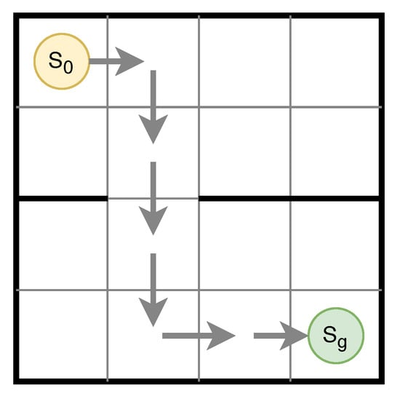
Options - Framework
In this example the initiation set and termination condition are represented as single states, and the intra-option policy is represented by the arrows. This type of option with a single initiation- and termination-state is often called a point option.
An example option, which takes the agent from the initiation state 𝑆0 located in one room, to the termination state 𝑆𝑔 in another room.

Slide 12
Options - Framework
Initiation Set
Termination Condition
Intra-Option Policy
Policy-over-Options

Slide 13
Options - Initiation Set
The initiation set of an option defines the states in which the option can be initiated.
A commonly used approach defines the initiation set as all states from which the agent is able to reliably reach the option its termination condition when following the intra-option policy, within a limited amount of steps. It is also usual to assume that for all states in which the policy of the option can continue, it can also be initiated.
For example, uses a logistic regression classifier to build an initiation set. States that were observed up to 250 time steps before triggering the option termination were labeled as positive initiation states for the selected option, states further away in the trajectory were used as negative examples.

Slide 14
Options - Termination Condition
The termination condition decides when an option will halt its execution. Similarly to the initiation set, a set of termination states is often used. Reaching a state in this set will cause the option to stop running. Termination states are better known as subgoal-states. Finding good termination states is often a matter of finding states with special properties (e.g., a well-connected state or states often visited on highly rewarded trajectories).
The most common termination condition is to end an option when it has reached a subgoal-state. However, this can lead to all kinds of problems. The option could for example run forever when it is not able to reach the subgoal-state. To solve this, a limitation of the allowed number of steps taken by the option policy is often also added to the termination condition.
A termination condition has also been considered when the agent is no longer active in its initiation set.

Slide 15
Options - Intra-Option Policy
If the initiation- and termination-set are specified, the internal policy of the option can be learned by using any RL method. The intra-option policy can be seen as a control policy over a region of the state-space.
The extrinsic reward signal is often not suitable in this case, because the overall goal does not necessarily align with the termination condition of the option. Alternatively the intra-option policy could solely be rewarded when triggering its termination condition. However, various denser intrinsic rewards signals could also be used. For example, if the termination condition is based upon a special characteristic of the environment, this property might serve as an intrinsic reward signal.
Intra-option policy learning can both happen on-policy and off-policy.

Slide 16
Options - Policy-over-Options
A policy-over-options 𝜋(𝜔|𝑠𝑡) selects an option 𝜔∈Ω given a state 𝑠𝑡. This additional policy can be useful to select the best option, when the current state belongs to multiple option initiation sets. It can also be used as an alternative to defining an initiation set for each option.
The most often used execution model is the call-and-return model. This approach is also often called hierarchical-execution. In this model a policy-over-options selects an option according to the current state. The agent follows this option, until the agent triggers the termination condition of the active option. After termination, the agent samples a new option to follow.

Slide 17
Options - Policy-over-Options
When considering a policy-over-options, we can identify different forms of optimality:
Hierarchical-optimal: a policy that achieves the maximum highest cumulative reward on the entire task.
Recursive-optimal: the different sub-behaviors of the agent are optimal individually.
A policy which is recursive-optimal might not be hierarchical-optimal. It is possible that there exists a better hierarchical policy, where the policy of a sub-task, might be locally suboptimal, in order for the overall policy to be optimal.
For example, if a sub-task consists of navigating to the exit of a room, the policy is recursive-optimal when the agent only fixates on this sub-task. However, a hierarchical-optimal solution might also take a slight detour to pick up a key, or charge its battery. These diversions negatively impact the performance of the sub-task, but improve the performance of the overall task.

